Slide 1
Tactile Defensiveness and
Tactile Dormancy:
What is the Relationship?
Jin-Shei Lai, PhD, OTR/L
Diane Parham, PhD, OTR, FAOTA
Cheryl Johnson-Ecker, MA, OTR/L, BCP

Slide 2

Sensory Dormancy and Defensiveness:
Two Sides of the
Same Coin?
Published in December 1999 issue of the Sensory Integration Special Interest Section Newsletter (Vol. 2, No. 4)
Partially supported by Maternal & Child Health Bureau

Slide 3
Research Problem
Association between defensiveness & dormancy should be high if same disorder
Defensiveness & dormancy should be manifested similarly in children with & without disabilities

Slide 4
Purpose of Study
Pilot investigation of tactile items on the Evaluation of Sensory Processing (ESP)
Association between defensiveness & dormancy examined using Rasch measurement

Slide 5
Instrument
61 tactile items on the ESP
Content validity: >.90
Criterion-related validity
Coefficient alpha: .95

Slide 6
Participants
34 children with disabilities
n=30 sensory integrative dysfunction
n= 4 autism
59 children with typical development
most children were 3 to 5 1/2 years old

Slide 7
Data Analysis
Items categorized as defensiveness or dormancy
Categorization verified using Rasch measurement model

Slide 8
Categorization of Items
8 items eliminated due to misfit
(MnSq > 1.7, Z score > 2.0)
40 items fit tactile defensiveness
13 items fit tactile dormancy

Slide 9
Rasch model
Items & children calibrated for severity of defensiveness or dormancy
Higher calibrations = less severity
Severity order of items should be the same if the two groups share same modulatory processes

Slide 10
Research Question 1
Are tactile defensiveness and tactile dormancy defining the same sensory modulation disorder?
If so, these two measures should not be different for individual children

Slide 11
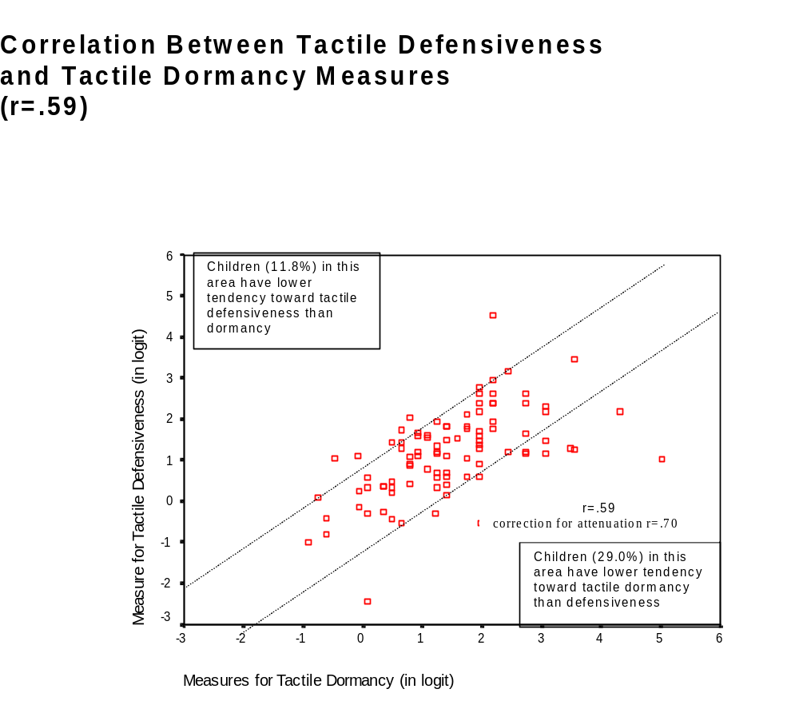

Slide 12
Research Question 2
Do children with and without disabilities share the same sensory modulation processes?
If so, item severity orders for the two groups should be highly correlated

Slide 13
Results
Tactile defensiveness: r = .79
corrected r = .91
Tactile dormancy: r = .90
corrected r = .98

Slide 14
Interpretation
Defensiveness & dormancy are related, but not necessarily the same disorder
Sensory modulation processes appear to be the same regardless of whether disability is present

Slide 15
Cautions
Reliance on parent questionnaire data
Only tactile system studied

Slide 16
Implications
Should the same intervention techniques be used for dormancy as for defensiveness?
Who should have intervention?
How is sensory modulation related to lifestyle & engagement in occupations?

